Slide 1

Documentation
Nhi Pham Pod 8: Victoria Pham Jenny Spicer
CSCI 5210 Software Engineering I, Fall 2024

Slide 2

Agenda
Introduction README Files Commit Messages
GitHub Pages & Wiki Auto-Documentation

Slide 3

Introduction
What is documentation?
Why is documentation important?
Types of documentation
https://blog.codacy.com/code-documentation#:~:text=Share:,better%20documentation%20for%20your%20code
Notes:
Documentation: handbook, details, instructions
Importance: clarity, maintainability (good engineering practices & design principles), collaboration, debugging, compliance
Types: embedded code (comments), files (readme - synopsis), long-form (wiki, API/Docstrings)

Slide 4
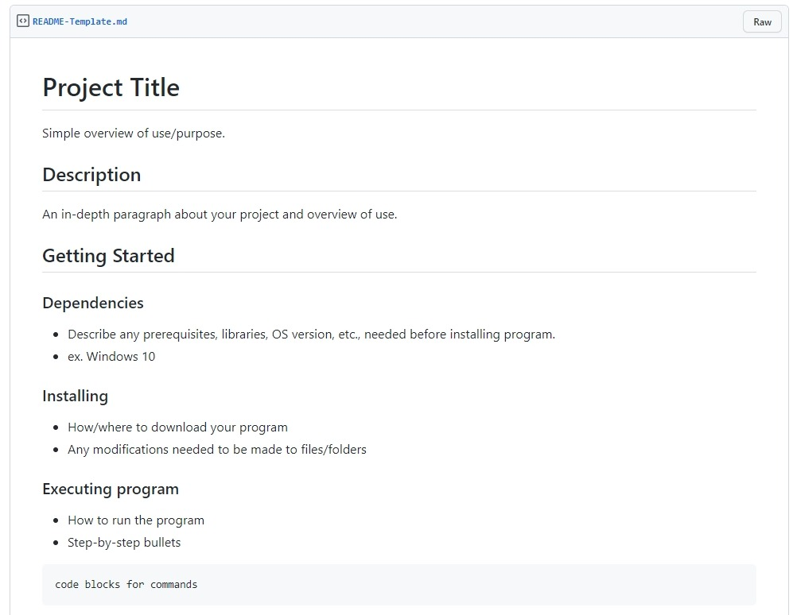
README Files
Introduction to project
Communicates important information
Especially crucial for open-source

Slide 5
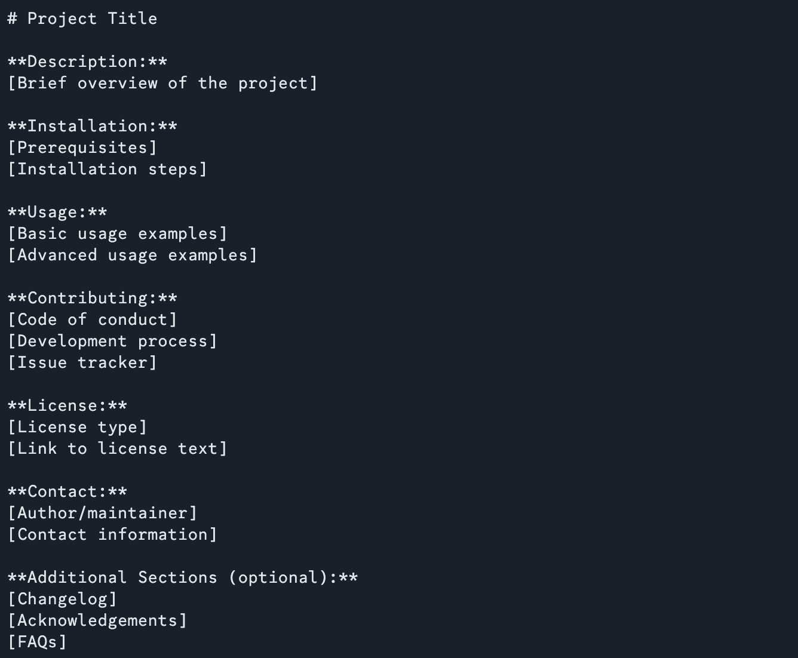








README Components
At a minimum:
Title
Description
Installation & Usage
How to Contribute
Licensing
Contact Information

Slide 6
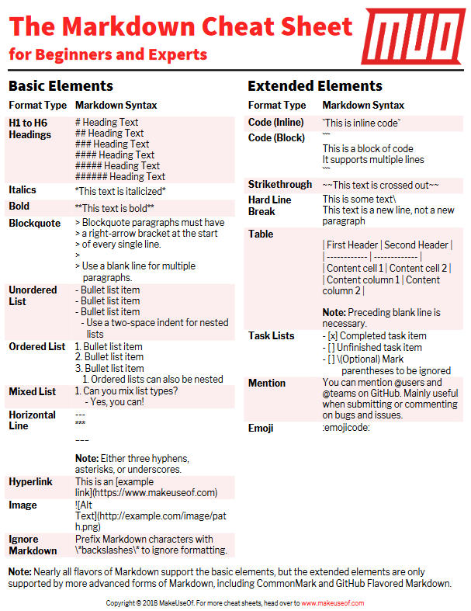
GitHub-Flavored Markdown
Markdown is...
Intuitive
Portable
Efficient
Versatile
https://www.markdownguide.org/basic-syntax/

Slide 7

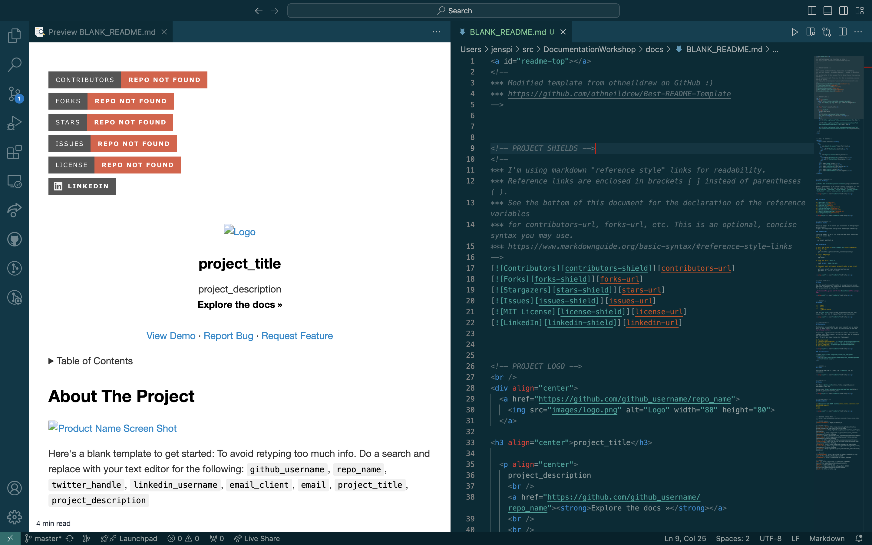
Easier README: VSCode
https://marketplace.visualstudio.com/items?itemName=shd101wyy.markdown-preview-enhanced

Slide 8
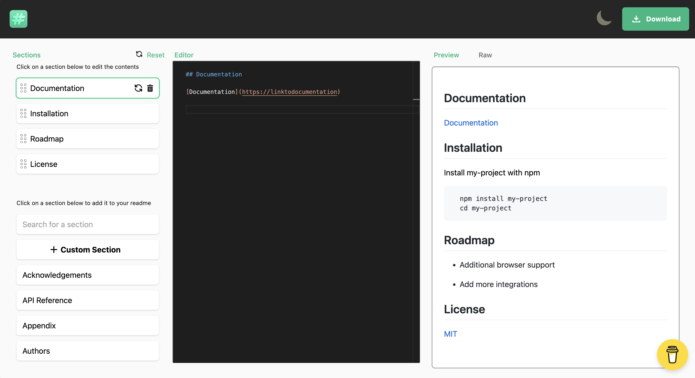
Easier README: readme.so
https://readme.so/

Slide 9
Keep Your README Up to Date!
First point of contact
Saves time
Encourages collaboration
Shows organization and professionalism
Discoverability

Slide 10
README Examples
Ours: https://github.com/bunnhimaybe/DocumentationWorkshop
Explore in your free time: https://github.com/matiassingers/awesome-readme

Slide 11
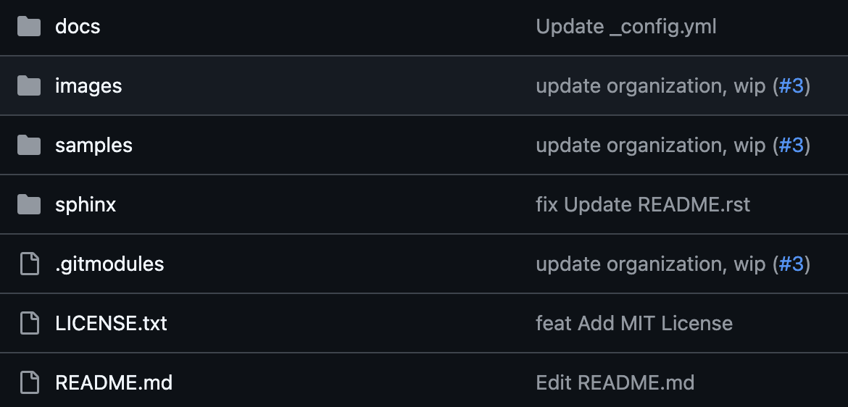
Introduction to Commit Messages
What is a commit message?
Brief description(s)
Why it is important
Tracking changes
Collaboration
Debugging
Code Review

Slide 12
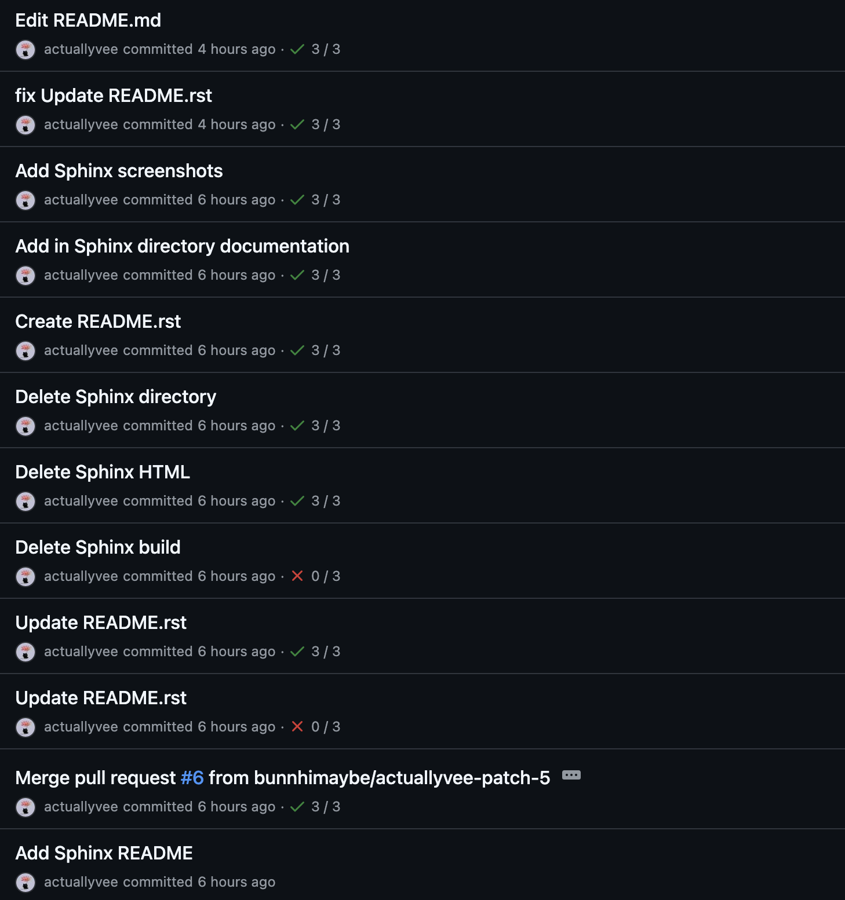
Best Practices
Capitalization and Punctuation
Imperative Action
Commit Type
feat , fix, refactor, docs, style
Length
Content
COMMIT MESSAGES
12

Slide 13
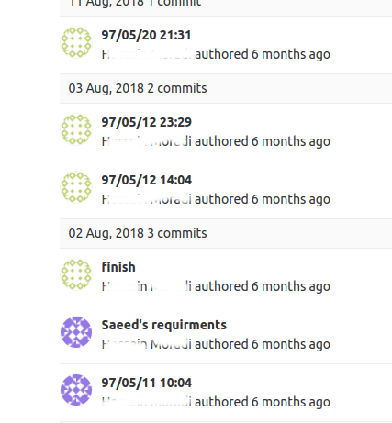
Common Mistakes
Rambling
Doesn't contain objective
COMMIT MESSAGES
13
Notes:
Source: https://linkedin.com/pulse/git-bad-practices-commit-messages-so-many-changes-one-mojtaba-rahimy/

Slide 14
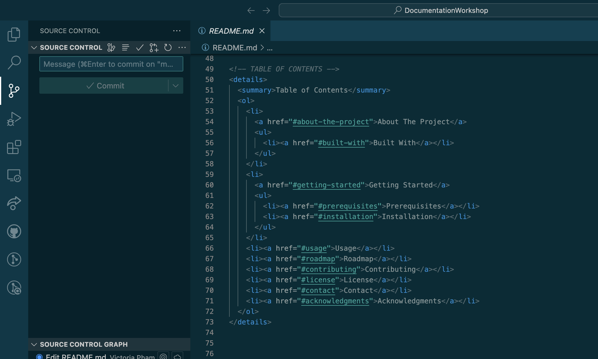
Commit How-to: VSCode

Slide 15
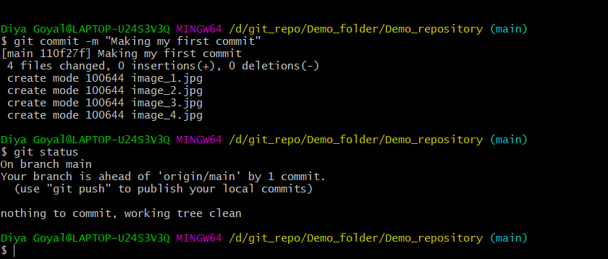


Commit How-to: Terminal

Slide 16
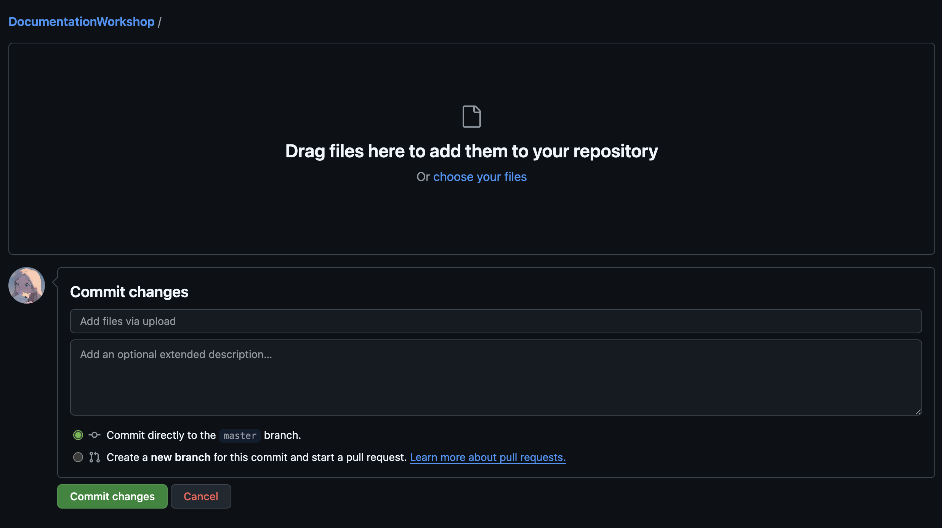

Commit How-to: In-browser

Slide 17

GitHub Education Student Developer Pack
Learning Paths
Experiences
Community Exchange Events Custom Domains
GitHub Pro –
Unlimited repositories Packages
Codespaces
Copilot
https://education.github.com/pack
Notes:
Experiences – skills
Codespaces – cloud coding environment

Slide 18
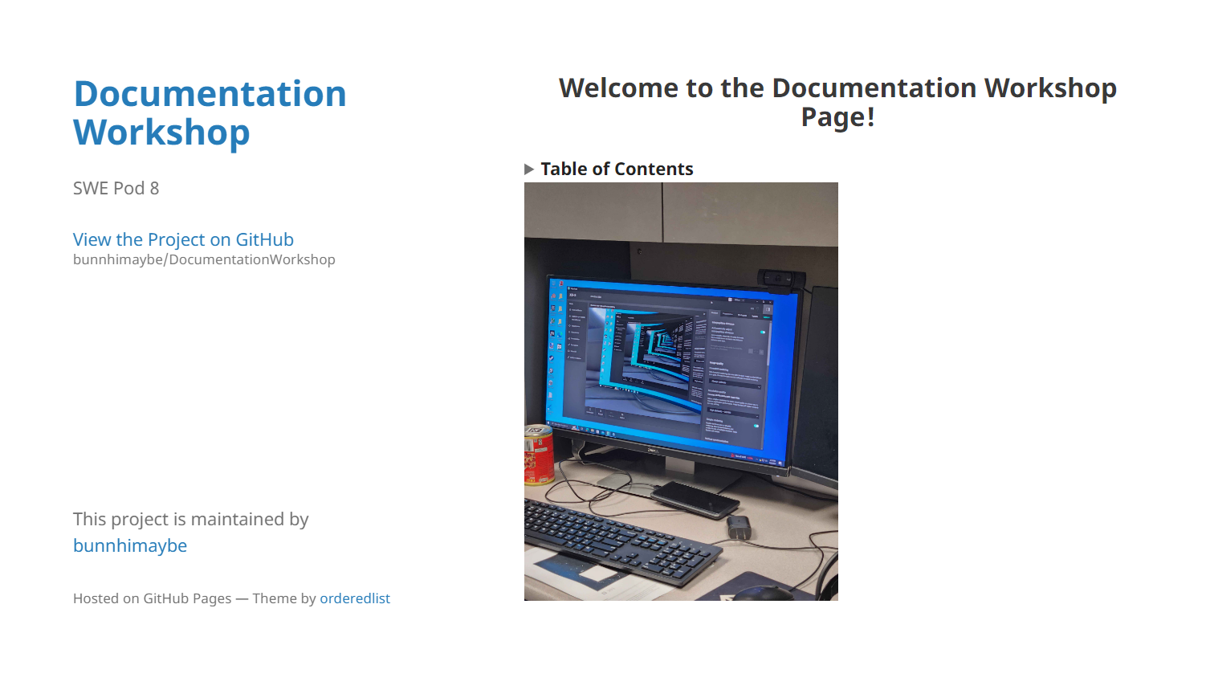
GitHub Pages
https://bunnhimaybe.github.io/DocumentationWorkshop/
Free static web hosting service
Accounts can have one user site and unlimited project sites
https://docs.github.com/en/pages
Notes:
Launch websites from repository

Slide 19
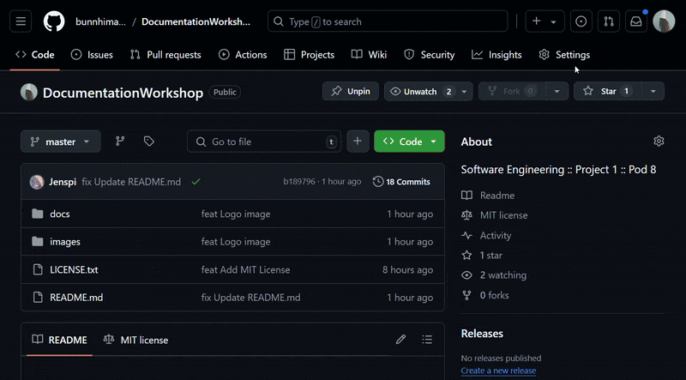
Set Up GitHub Pages
1. Create repository
* User default: username.github.io
2. Clone repository
3. Create entry file (index.html or README.md)
4. Publish
5. Enable GitHub Pages
https://pages.github.com/

Slide 20
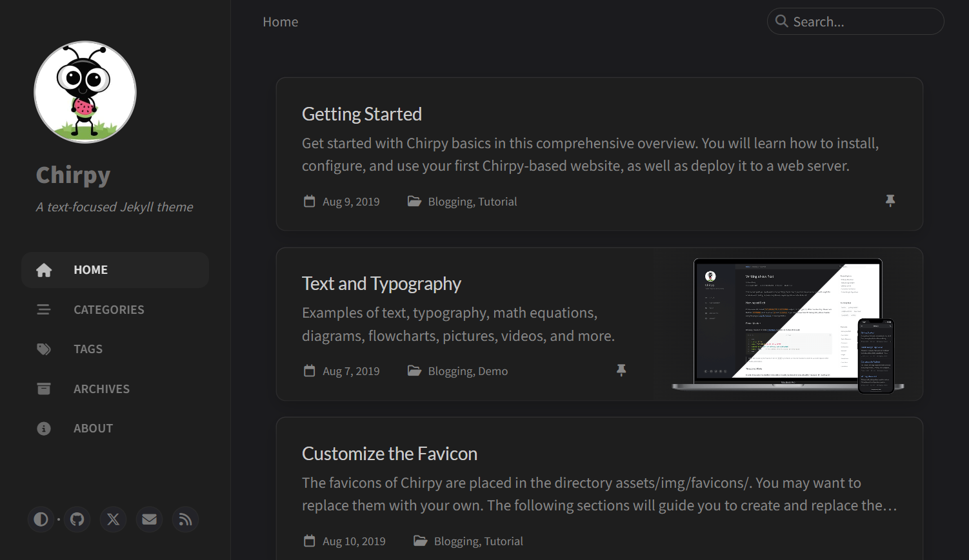
Deployment
https://github.com/cotes2020/jekyll-theme-chirpy
GitHub Actions
enabled to use built-in Jekyll
From a branch
Other builds
Disable Github Actions and add .nojekyll file to root to deploy the content directly
https://docs.github.com/en/pages/getting-started-with-github-pages/configuring-a-publishing-source-for-your-github-pages-site
Notes:
publishing

Slide 21

Customization
Jekyll Themes
Supported Themes https://pages.github.com/themes/
Templetes
HTML
Repositories
Custom Domains
https://themefisher.com/products/kross-bootstrap
Notes:
Custom Domains: CNAME file – redirect from included site to Page, DNS settings
Supported Themes:
Remote Themes: use templete repository (remote_theme:?)
Template - Chirpy: https://github.com/cotes2020/jekyll-theme-chirpy
https://chirpy.cotes.page/
Frameworks: https://jenspi.github.io/

Slide 22
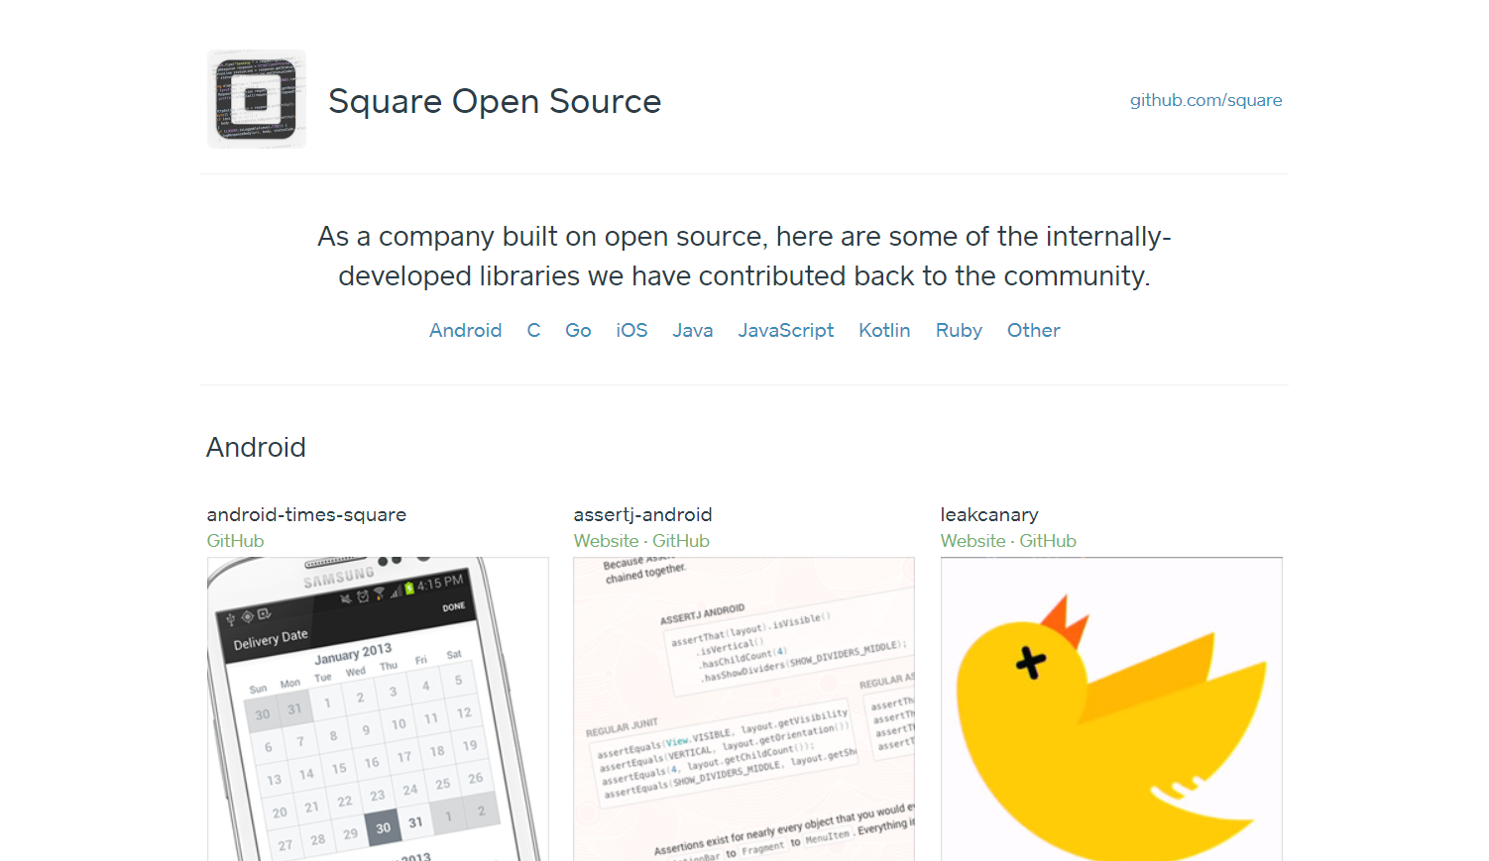
Best Practices
detailed
up-to-date
well-structured and easy to navigate
uses Markdown formatting
GITHUB pages
https://square.github.io

Slide 23
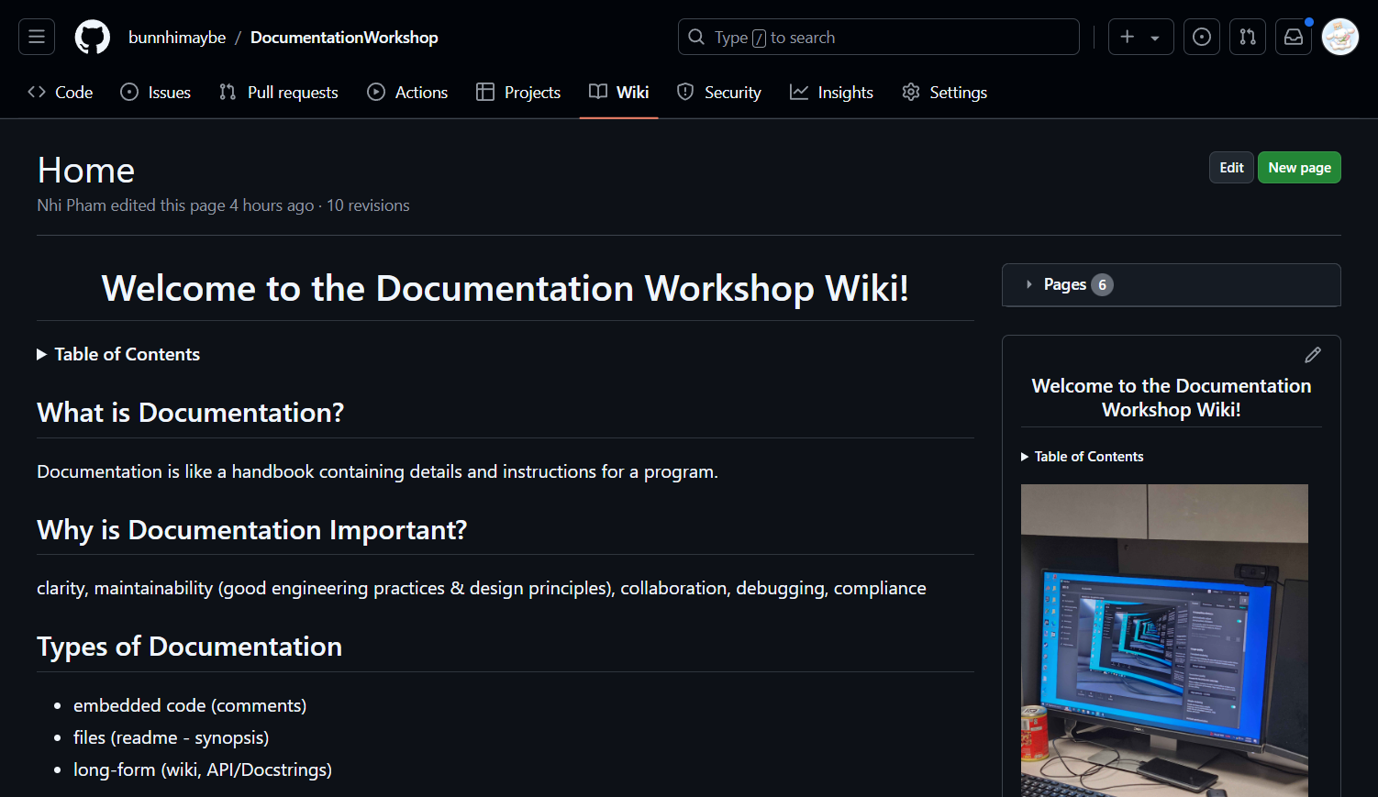
GitHub Wikis
Host long-form documentation within repositories
Edit in-browser or clone locally
https://github.com/bunnhimaybe/DocumentationWorkshop/wiki

Slide 24
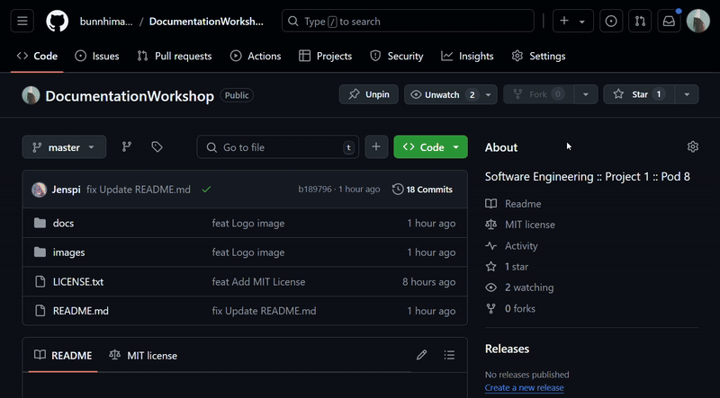
Set Up GitHub Wikis
A section to host long-form documentation within your repository
Cloning
Header
Footer
Sidebar
https://docs.github.com/communities/about-wikis

Slide 25
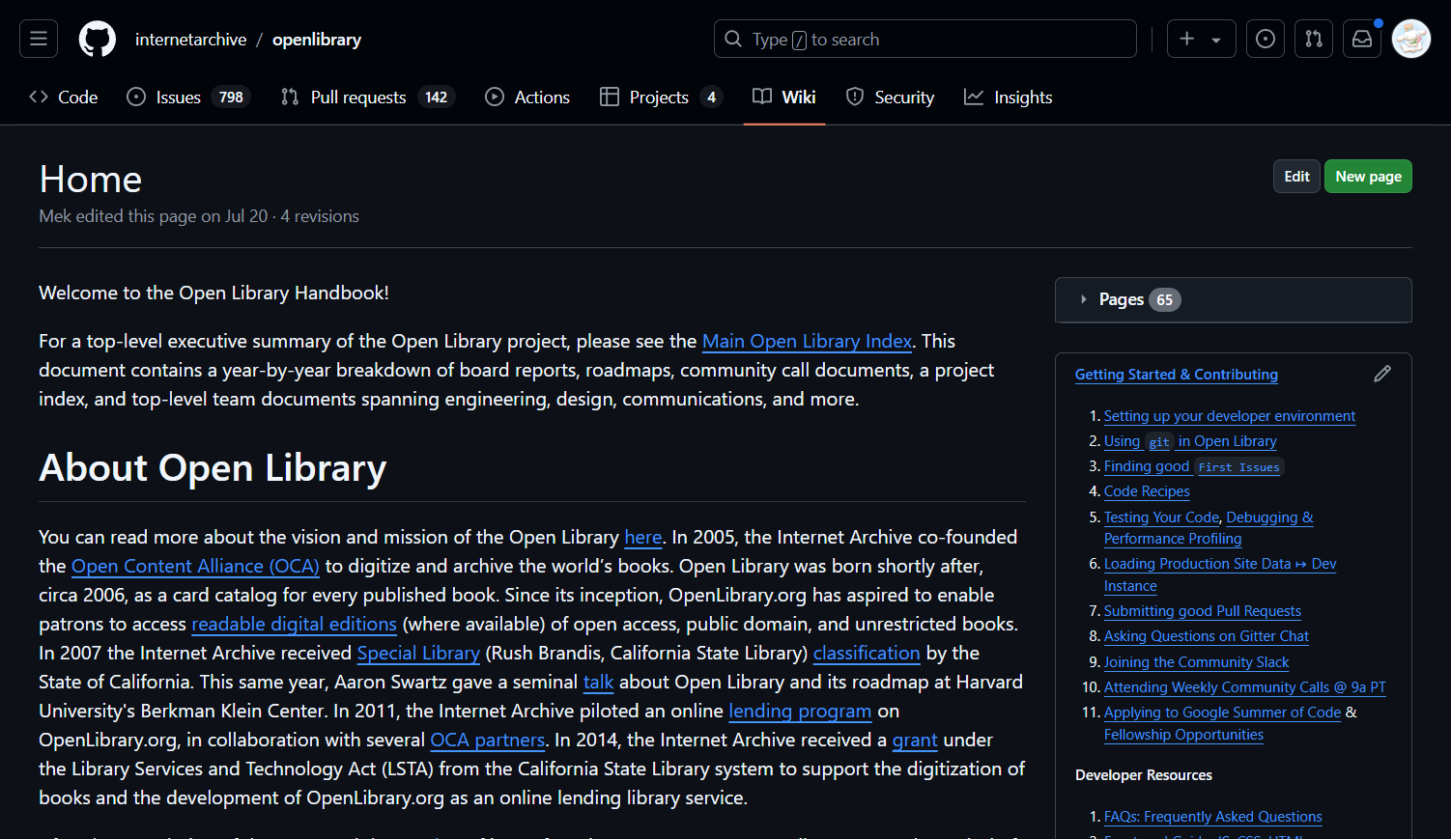
Best Practices
detailed and up-to-date
well-structured and easy to navigate
uses Markdown formatting
doesn't repeat README information
Guidelines: https://github.com/MyHoneyBadger/awesome-github-wiki
Example: https://github.com/internetarchive/openlibrary/wiki
GITHUB WIKIS
https://github.com/bunnhimaybe/DocumentationWorkshop/wiki

Slide 26
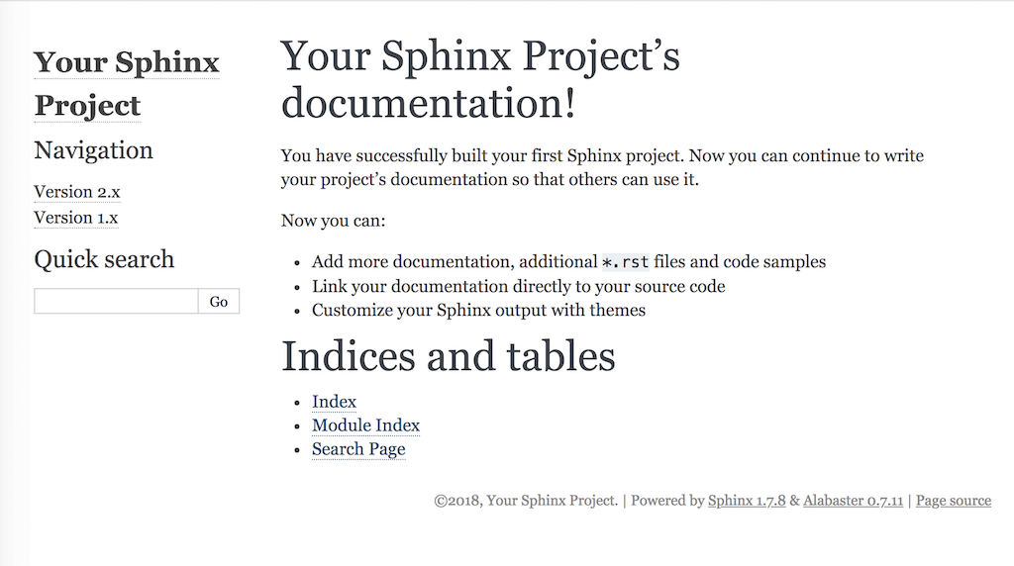
Sphinx
Auto-documentation generator tool for various documentation files that can create webpages, PDF, and ePub
Uses reStructured Text and Markdowns

Slide 27
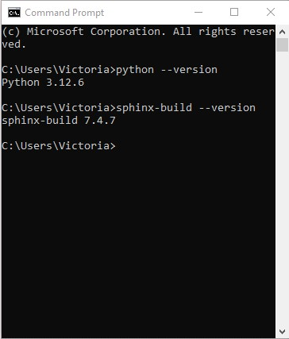
Installation of Sphinx
Prerequisite: Must have Python V.3+ installed.
Windows: Make sure to check-mark 'pip' and 'PATH' during download set-up.
MacOS: Check version via 'python3' command
TERMINAL COMMAND:
Windows: $ pip install -U sphinx​
Linux: $ apt-get install python3-sphinx​
MacOS: $ brew install sphinx-doc

Slide 28
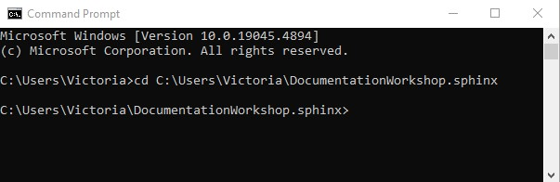
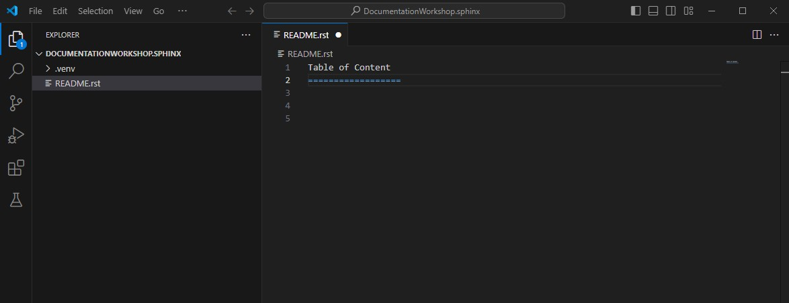
Environment Set-Up
FOLDER AND PATHWAY:
Create a folder in a directory
Pathway: C Drive > Users > [YourFolder] > [CreateFolder]
Open [CreateFolder] in Visual Code Studio (VS)
Create a new file and name it README.rst

Slide 29
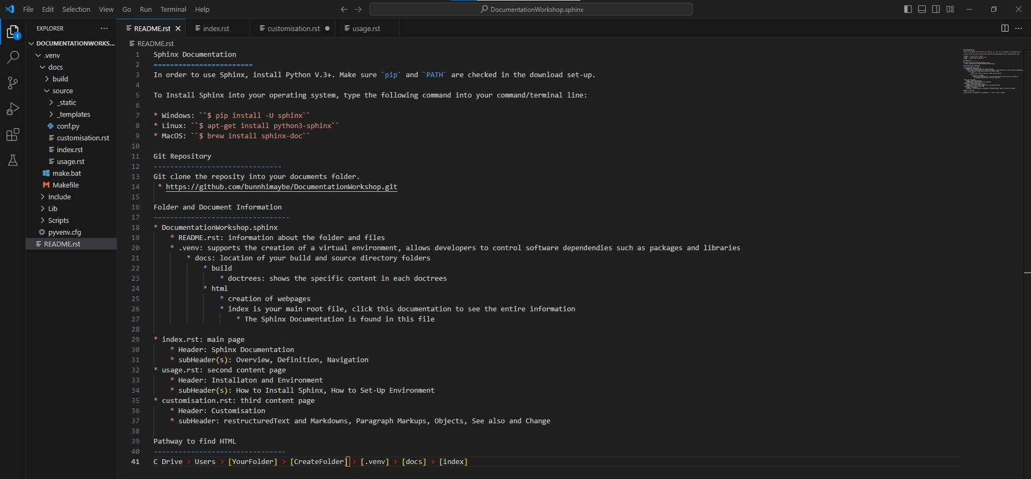
README.rst

Slide 30
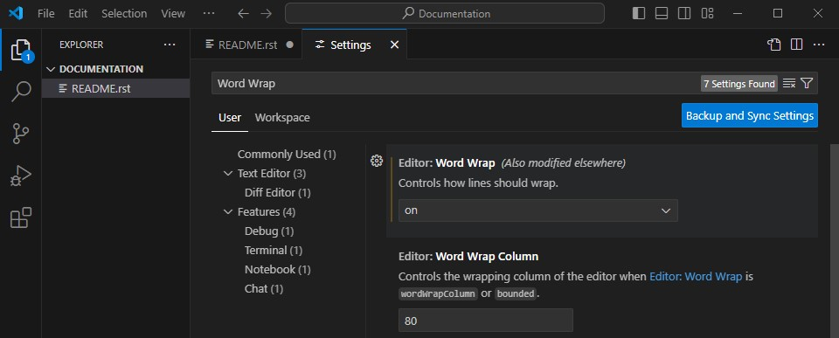
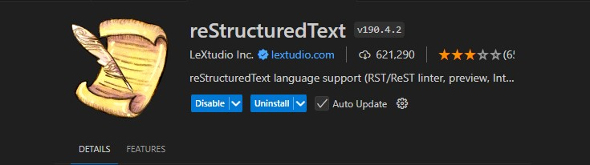
VS SETTINGS & EXTENSIONS
Wordwrap allows a string to be broken into new lines when it reaches a specific length
reStructured Text language support, note the extension should be customised to allow 'enter' and 'backspacing'

Slide 31
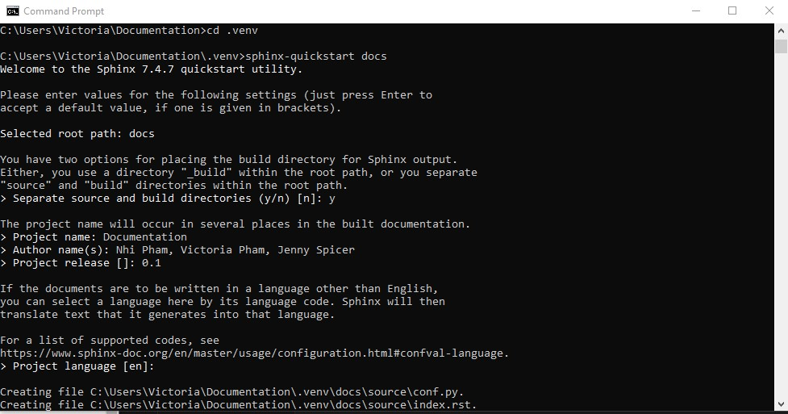
Environment Set-Up
TERMINAL COMMAND AND VS:
Change directory to the [CreateFolder] pathway and type the following:​
python -m venv .venv​
Change directory to the \CreateFolder\.venv pathway and type the following:​
sphinx-quickstart docs​
Separate source and build directory, choose ‘yes’
Insert project name, author, release, and language information

Slide 32
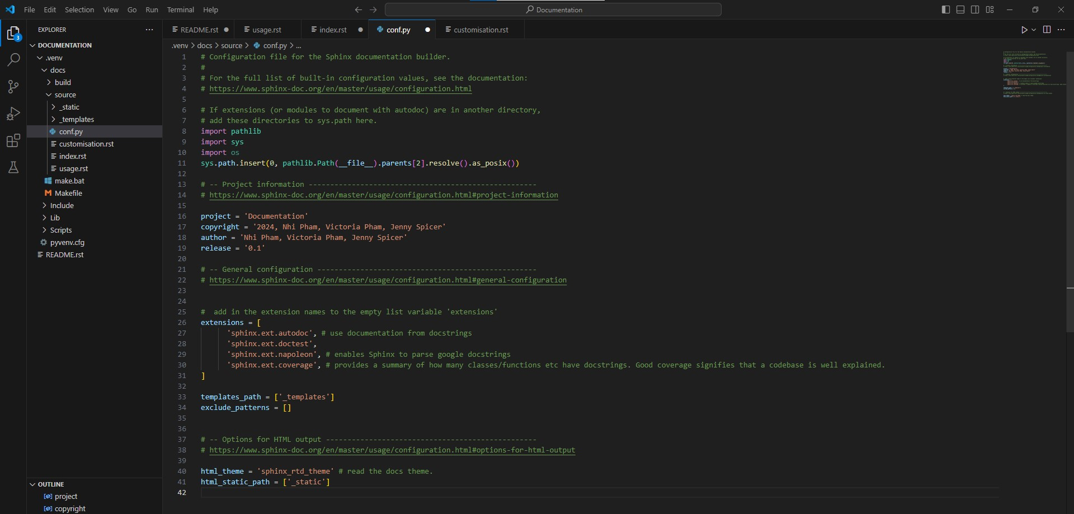
CONFIG.PY
system libraries, source codes (py), project information, extensions, themes

Slide 33
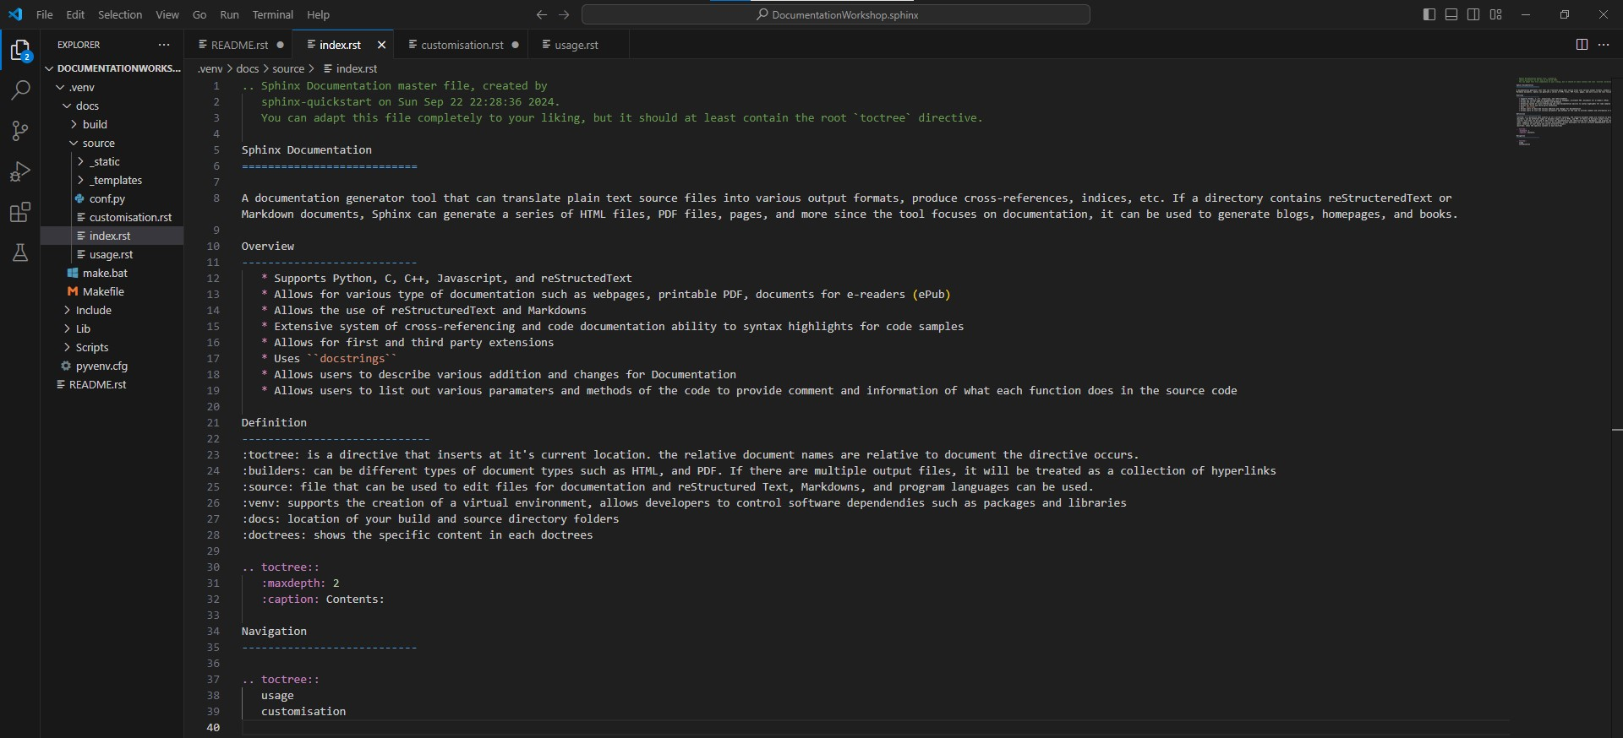
INDEX RST FILE
main root file, first page seen in the document, includes toctree and navigation

Slide 34
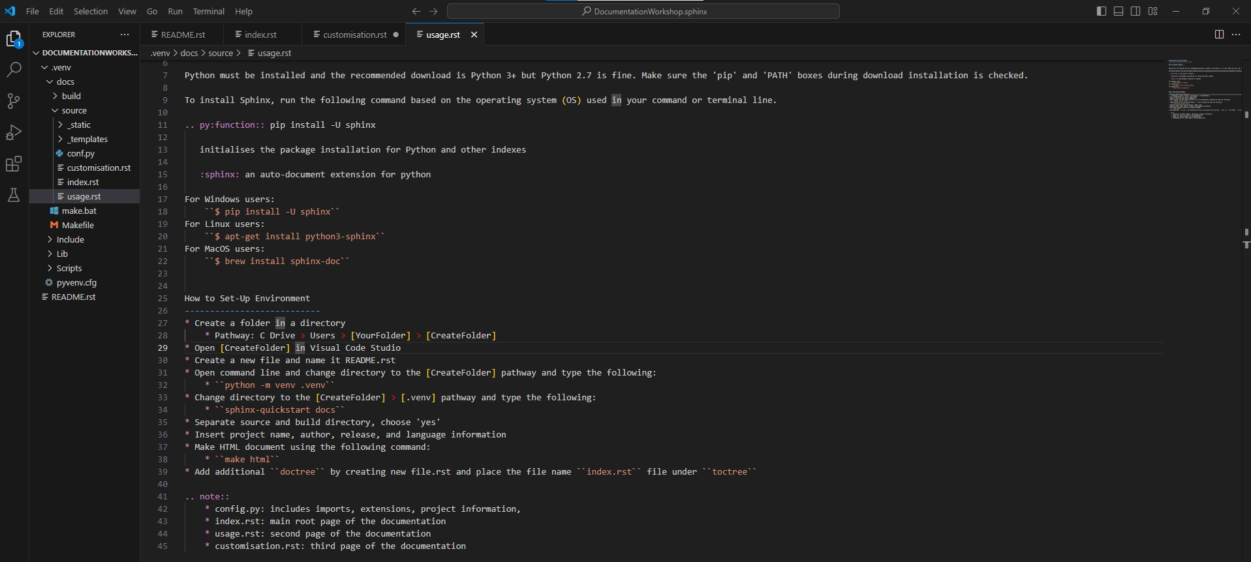
USAGE RST FILE
second navigation file, file name 'usage' must be included in index file in the toctree

Slide 35
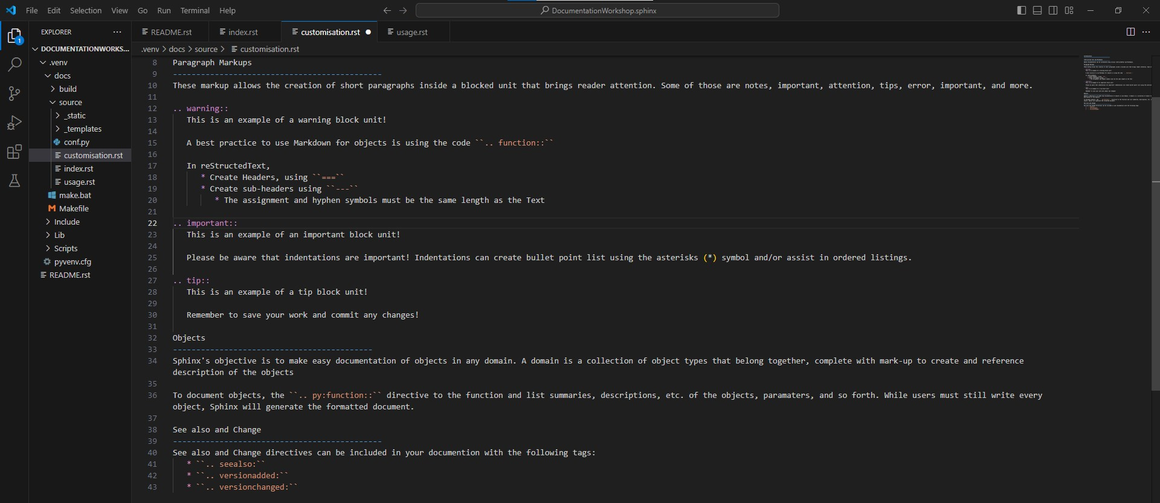
CUSTOMISATION RST FILE
third navigation file, file name 'customisation' must be included in index file in the toctree​

Slide 36
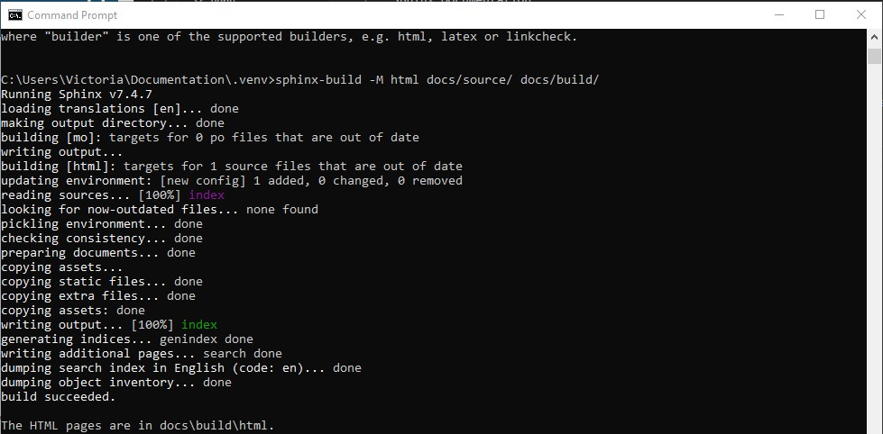
SPHINX BUILD: HTML FILE
sphinx build M html docs/source docs/build , build and source folders

Slide 37
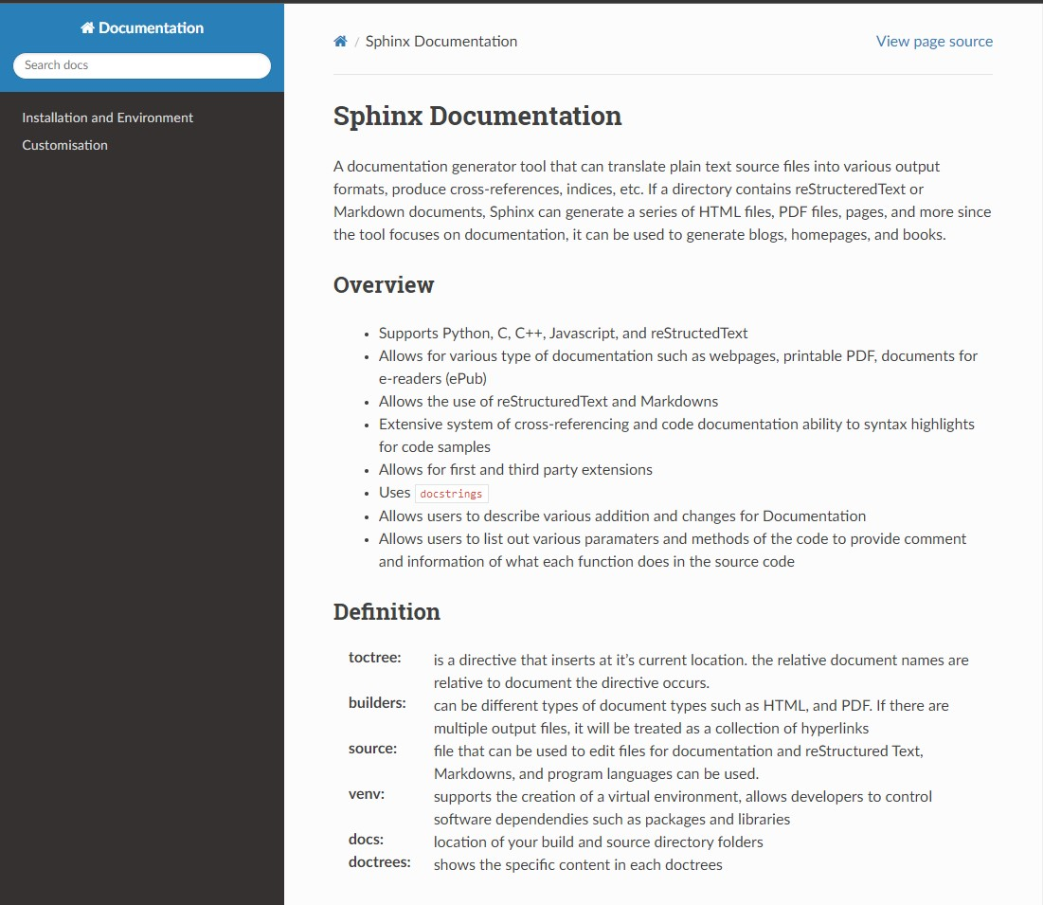
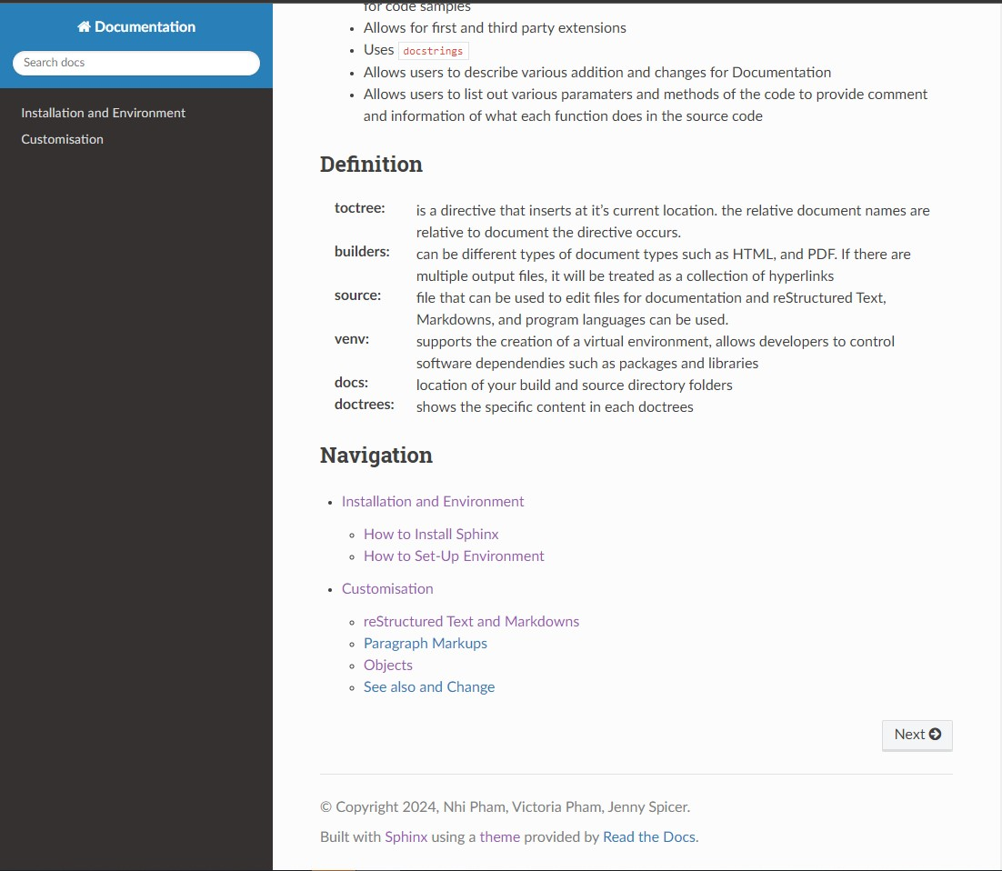
SPHINX DOCUMENTATION RESULTS
GitHub Page: https://actuallyvee.github.io/sphinx/

Slide 38
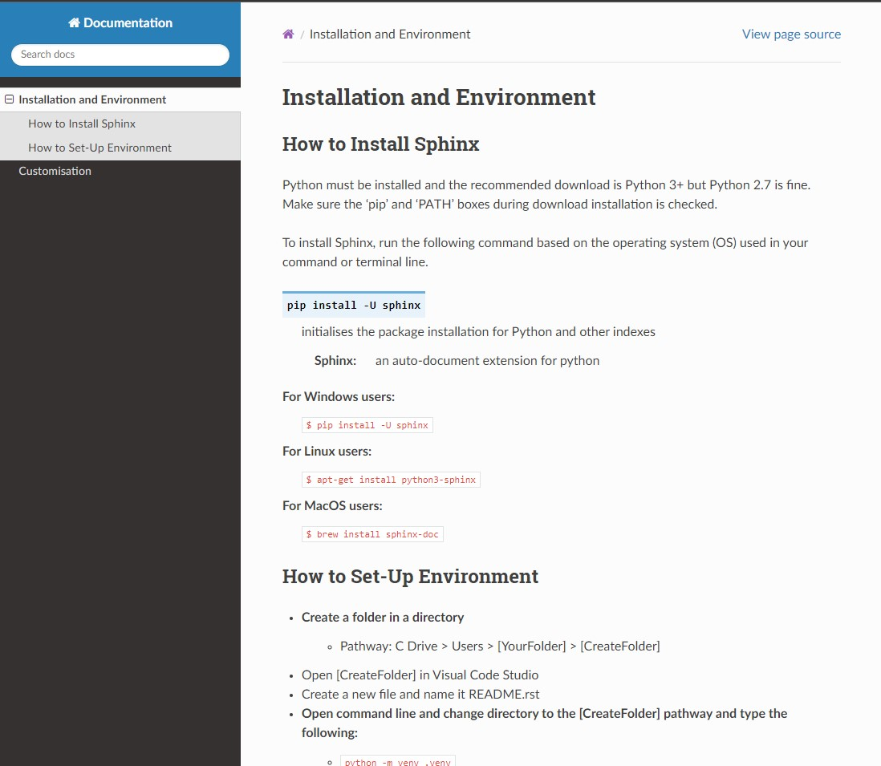
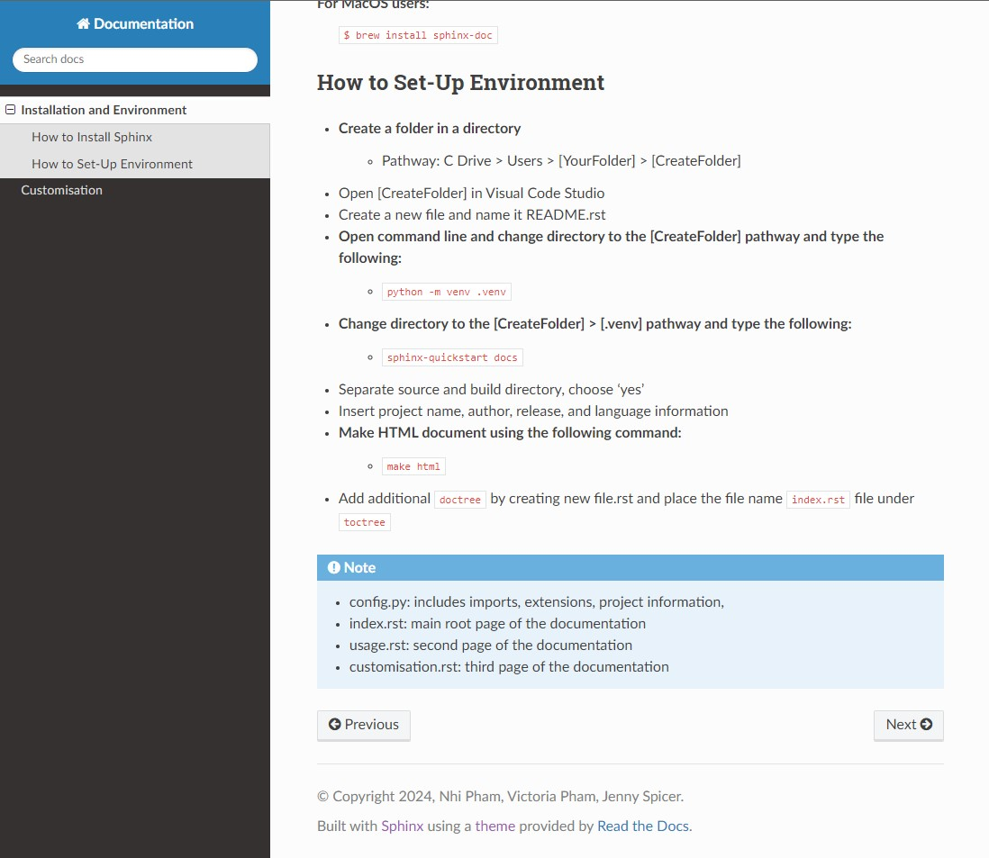
SPHINX DOCUMENTATION RESULTS
header: installation and environment, subHeader: how-to install, set-up, and folder directory

Slide 39
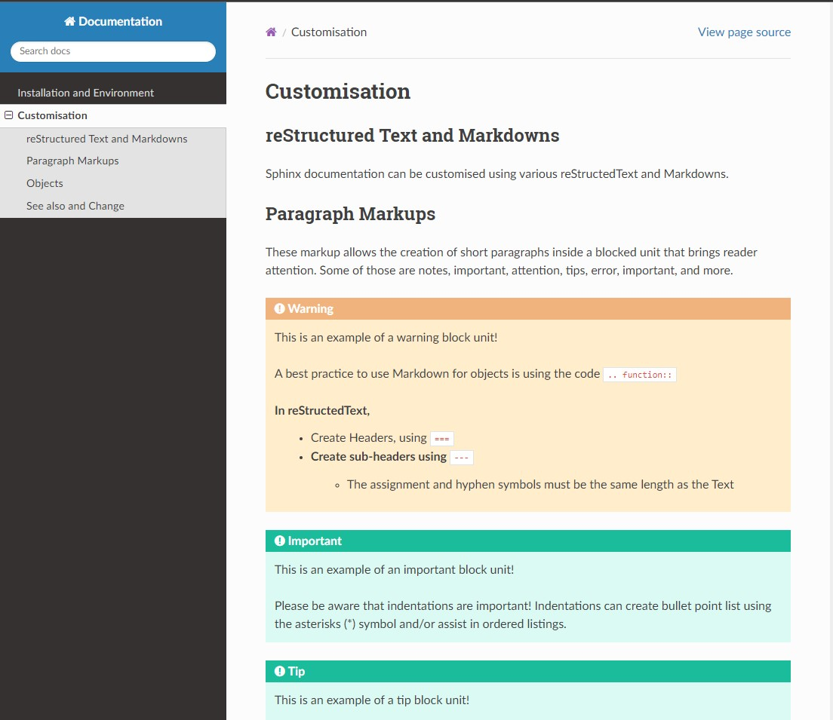
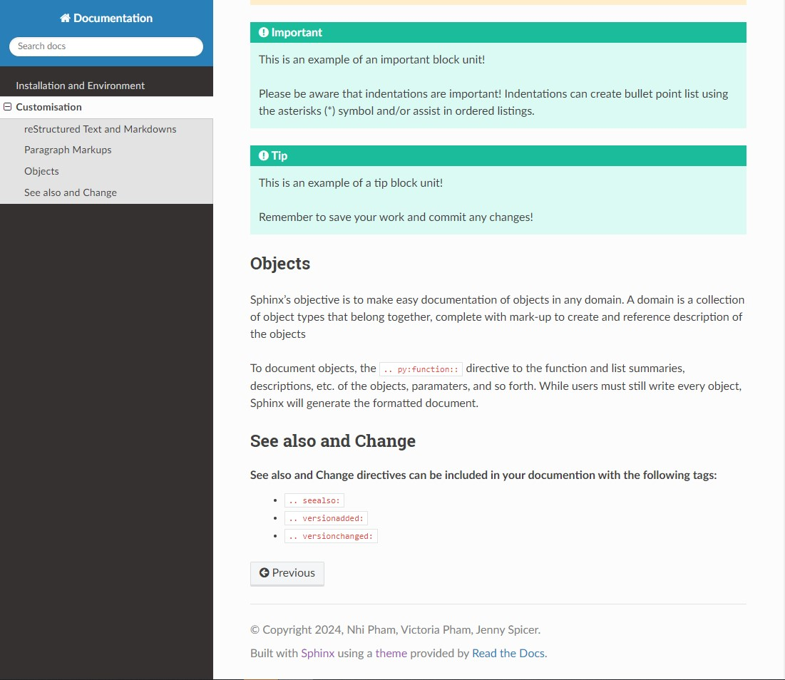
SPHINX DOCUMENTATION RESULTS
header: customisation , subheader: reStructuredtext, objects, see also and change

Slide 40
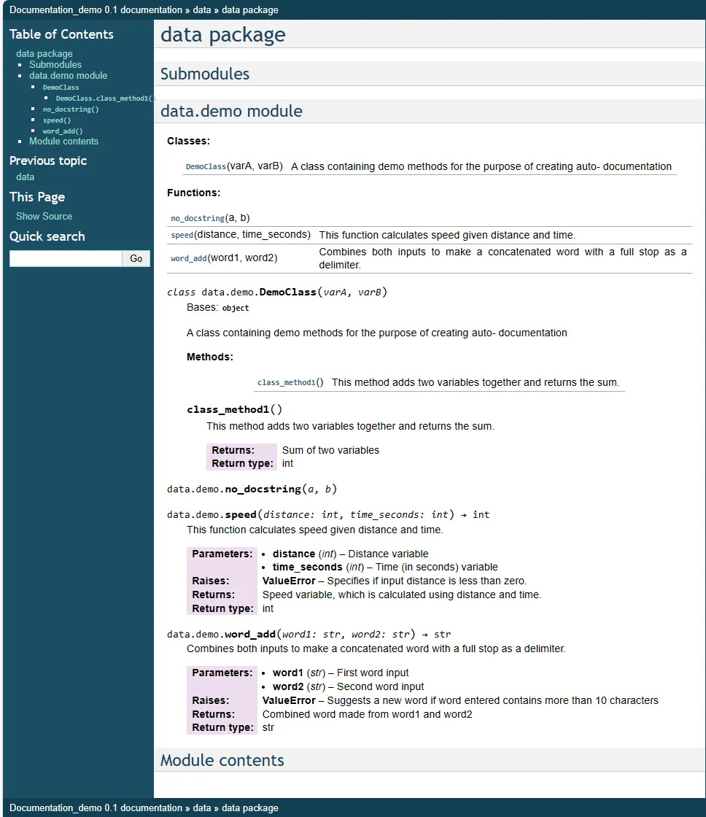
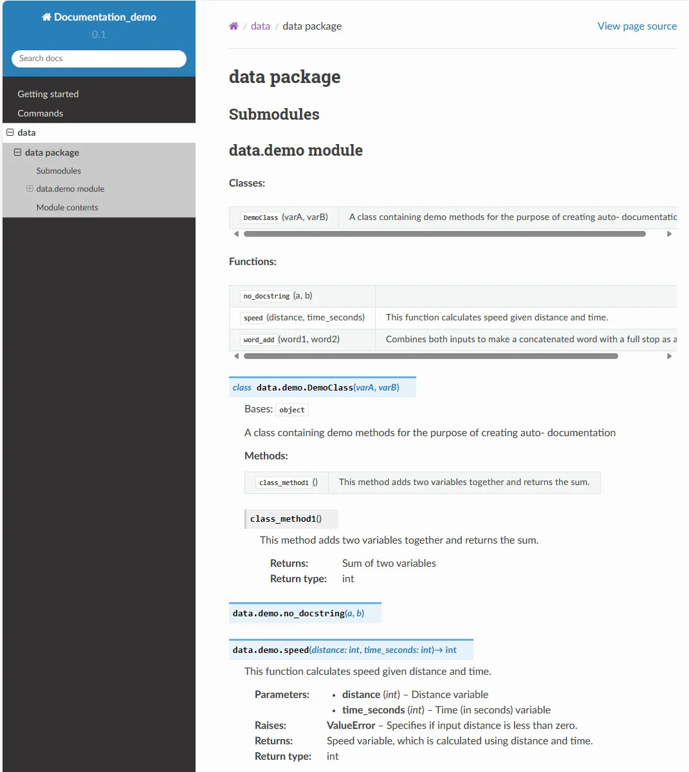
OTHER EXAMPLES (MORE OBJECT)
Lucy Dickinson: Code Autodocumentation , expected input and output in source file codes, similar to creating a javadoc but markdowns

Slide 41
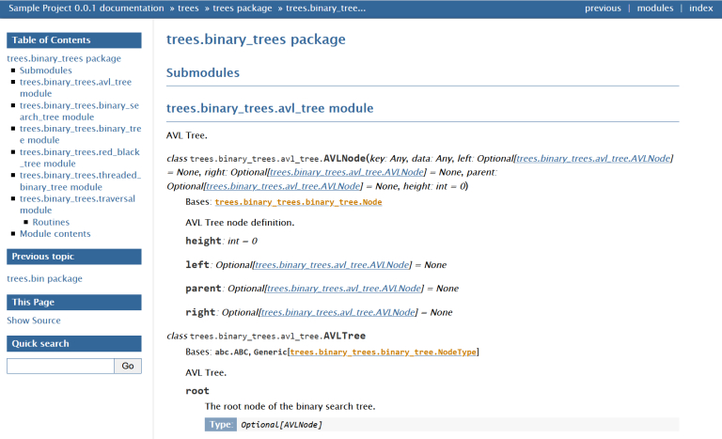
OTHER EXAMPLES (MORE OBJECT)
Shun Huang: Documentation

Slide 42
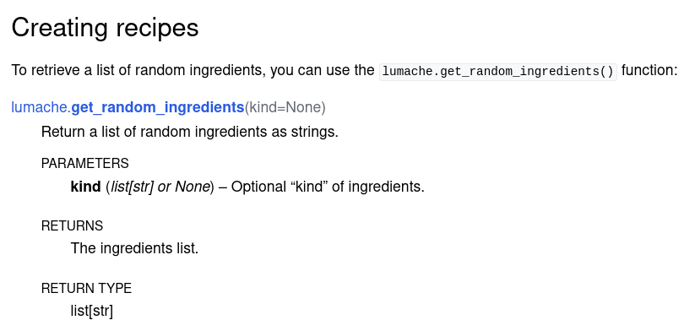
OTHER EXAMPLES (MORE OBJECT)
Sphinx: Code Documentation

Slide 43
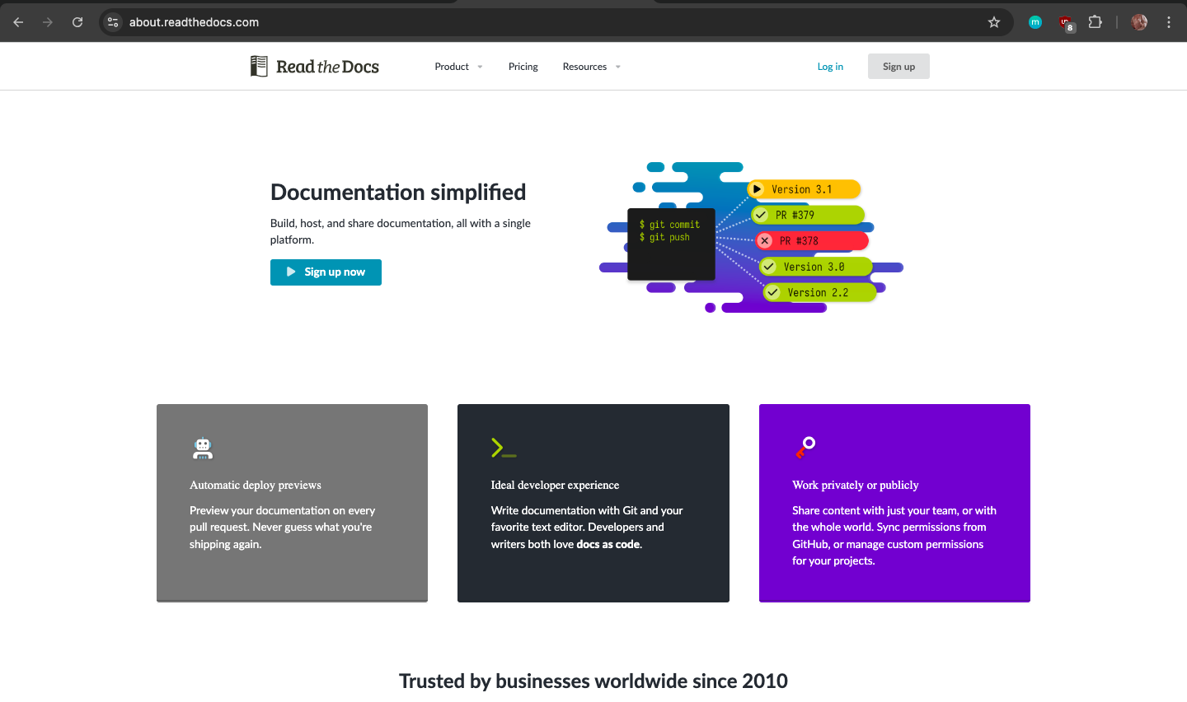
Read the Docs
Sphinx documentation can be hosted on Read the Docs
Theme was chosen from this platform
Another resourceful documentation tool
Sign-up using email or GitHub account
Should be able to clone and/or import repository

Slide 44

In-Class Activity
Looking at a sample README...
https://github.com/bunnhimaybe/DocumentationWorkshop/blob/master/samples/BAD_README.md
What makes it good or not good?
What changes could be made?
Something's kinda weird about it....

Slide 45
Deliverables
Each pod chooses at least 1 documentation tool to create and deliver:
GitHub README
GitHub User or Project Page
GitHub Wiki

